Slide 1
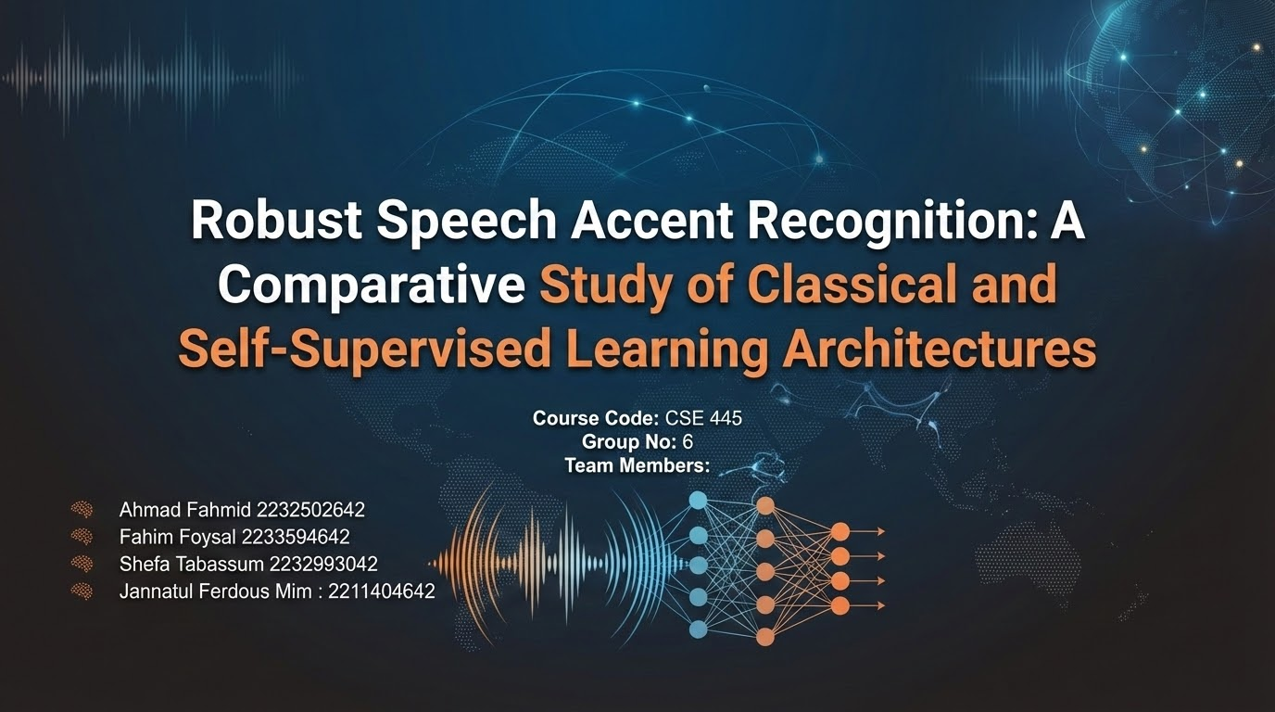

Slide 2
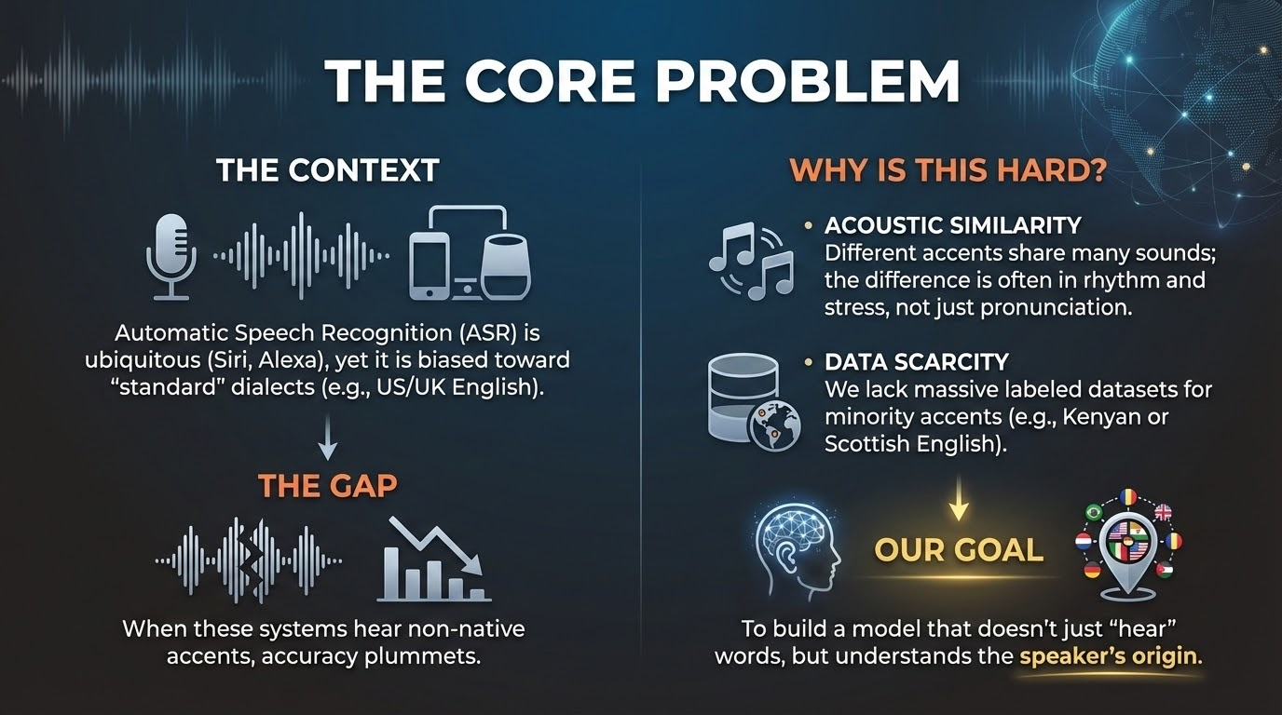
Group 06: Ahmad Fahmid , Fahim Foysal, Shefa Tabassum, Jannatul Ferdous Mim

Slide 3
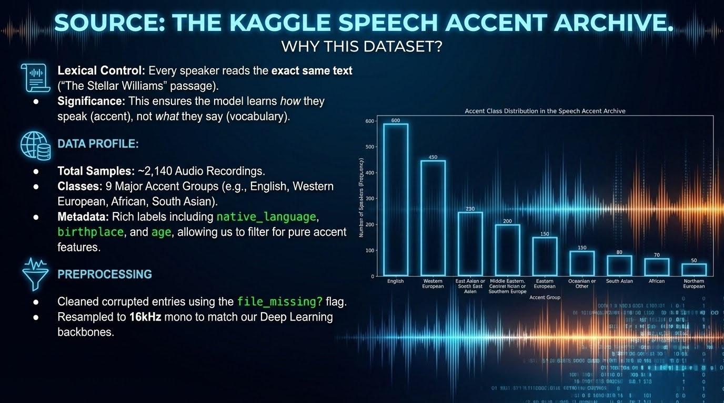
Group 06: Ahmad Fahmid , Fahim Foysal, Shefa Tabassum, Jannatul Ferdous Mim

Slide 4
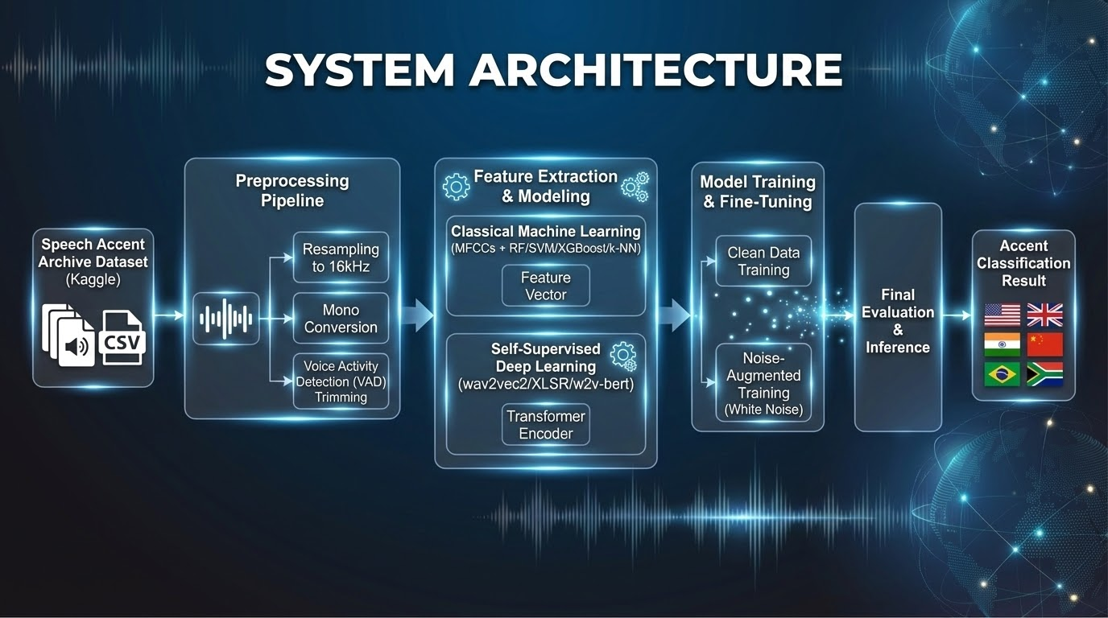
Group 06: Ahmad Fahmid , Fahim Foysal, Shefa Tabassum, Jannatul Ferdous Mim

Slide 5
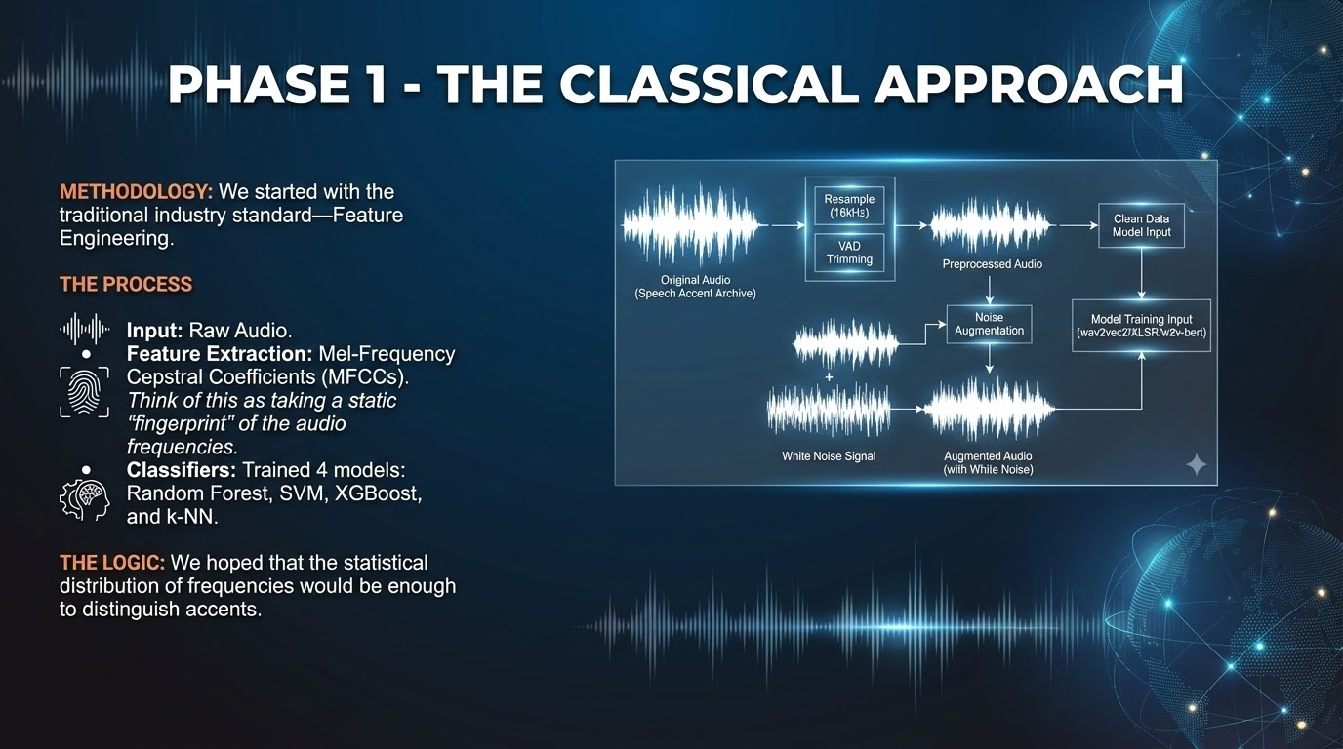
Group 06: Ahmad Fahmid , Fahim Foysal, Shefa Tabassum, Jannatul Ferdous Mim

Slide 6
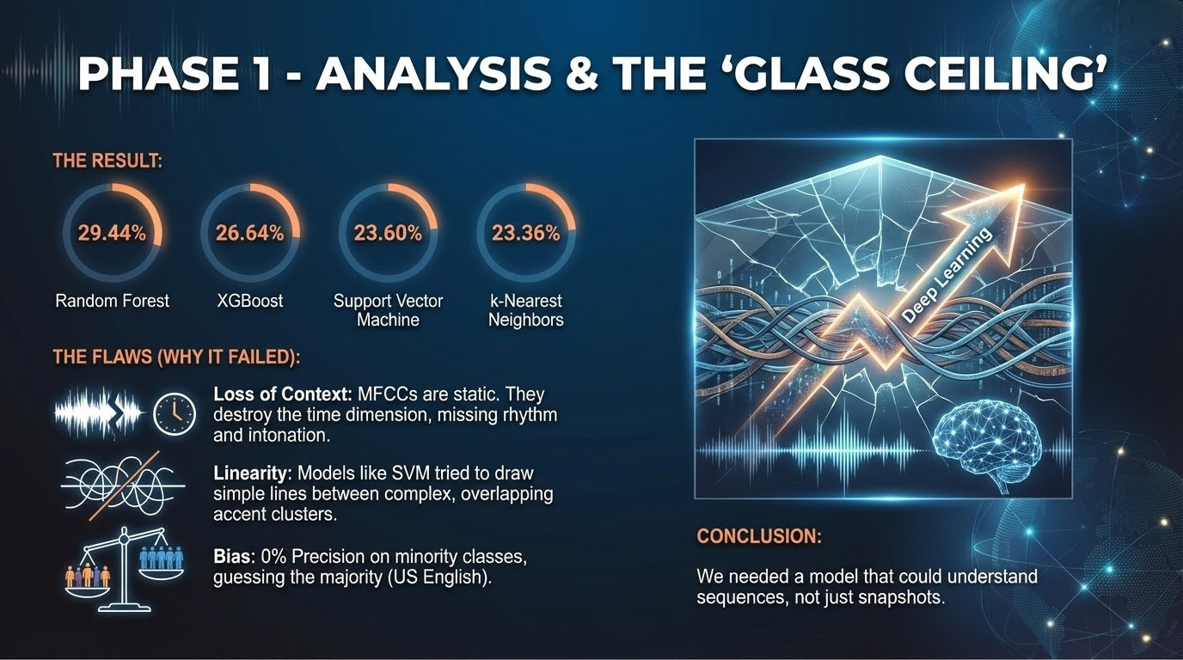
Group 06: Ahmad Fahmid , Fahim Foysal, Shefa Tabassum, Jannatul Ferdous Mim

Slide 7
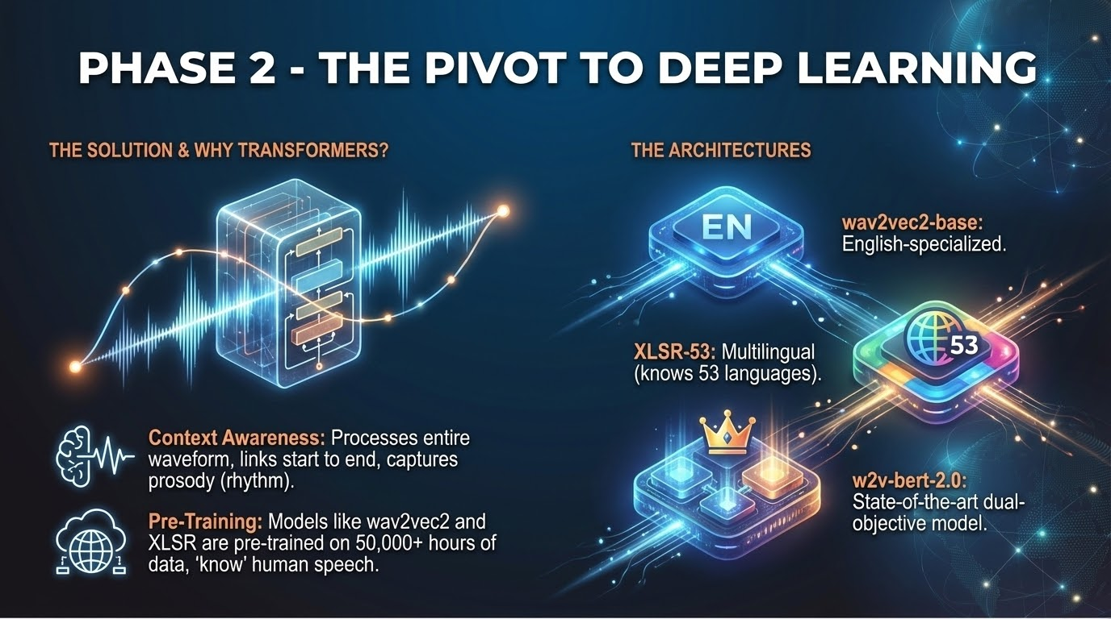
Group 06: Ahmad Fahmid , Fahim Foysal, Shefa Tabassum, Jannatul Ferdous Mim

Slide 8
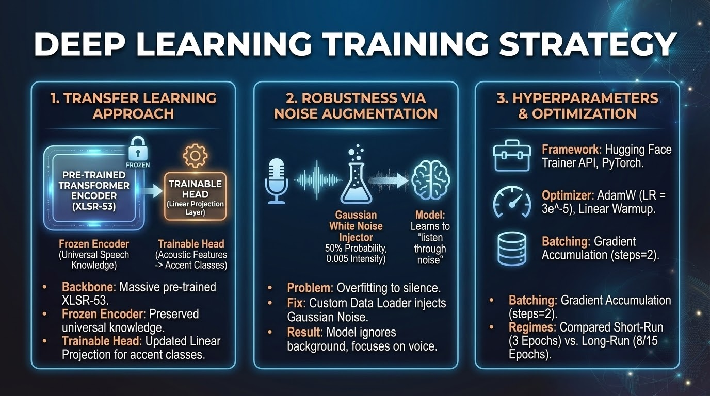
Group 06: Ahmad Fahmid , Fahim Foysal, Shefa Tabassum, Jannatul Ferdous Mim

Slide 9
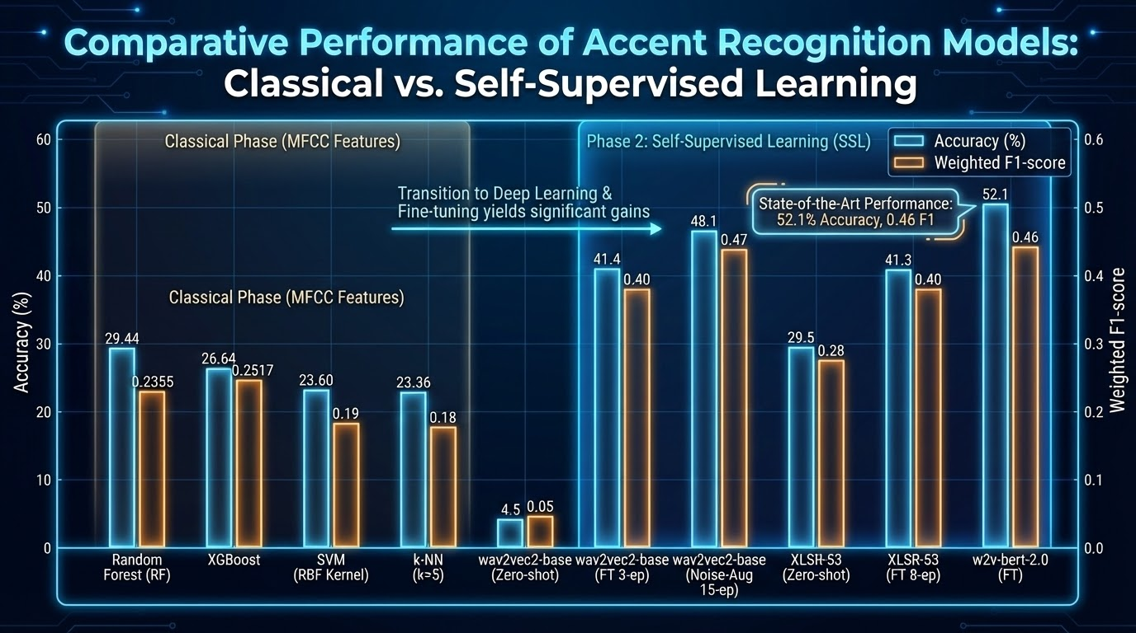
Group 06: Ahmad Fahmid , Fahim Foysal, Shefa Tabassum, Jannatul Ferdous Mim

Slide 10
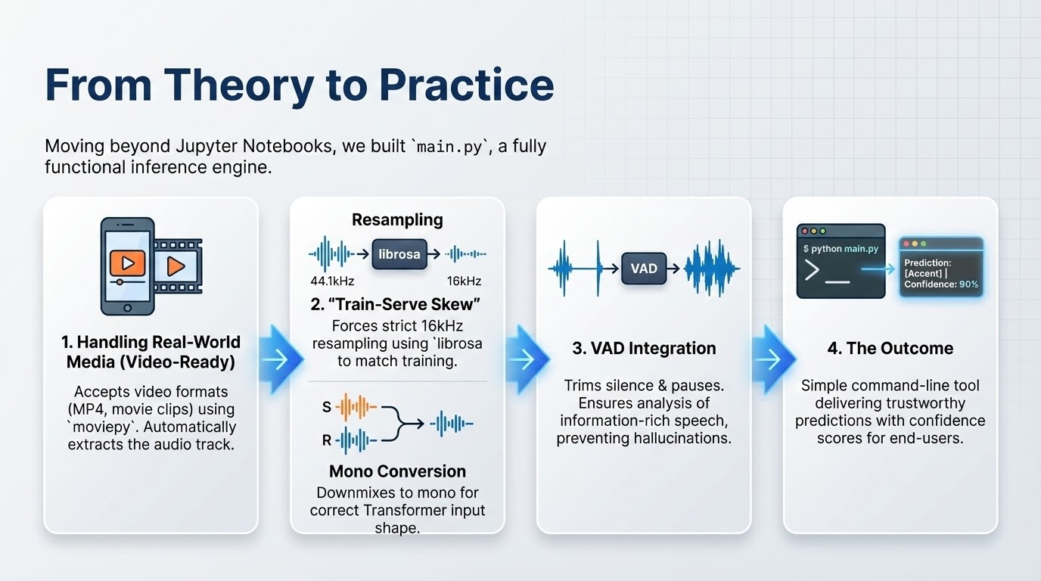
Group 06: Ahmad Fahmid , Fahim Foysal, Shefa Tabassum, Jannatul Ferdous Mim

Slide 11
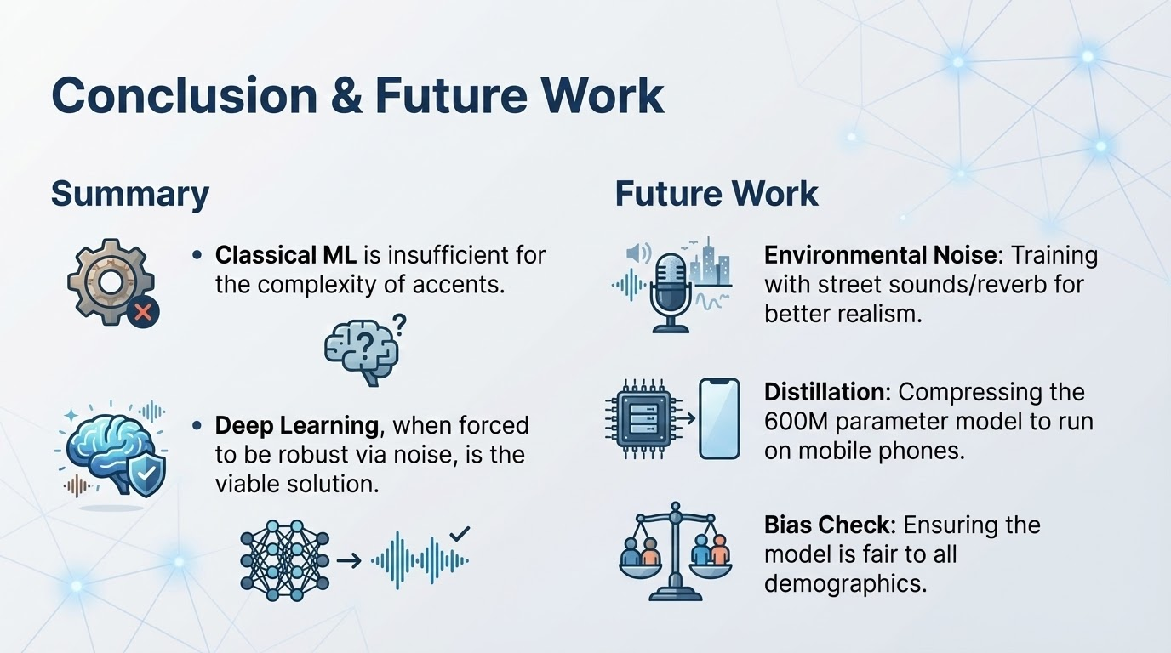
Group 06: Ahmad Fahmid , Fahim Foysal, Shefa Tabassum, Jannatul Ferdous Mim

